Slide 1
Business Opportunities near European Stations
IBM Capstone data project

Slide 2
Introduction
Europe has 817 major and 56173 minor train stations
European railway network carries 8+ billion passengers to their destinations
Scope of investment to attract consumers is huge
Target is to analyze existing facilities and services in major train stations in Europe
To suggest investments as per locations

Slide 3
Business problem
Analyze the most common investments near major train stations across Europe
Identify trends among services provided across various regions in Europe
Suggest a new business investment opportunity for establishing franchises, expanding to new markets or create a new service industries near train stations

Slide 4
Data acquisition and cleansing
The data is part of Kaggle dataset and is available at GitHub repository: https://github.com/trainline-eu/stations
Original data frame contains 12 columns and 56,990 rows
Due to API limitations, only major train stations are considered.
After cleaning the dataset, final dataset contains 3 columns and 791 columns

Slide 5
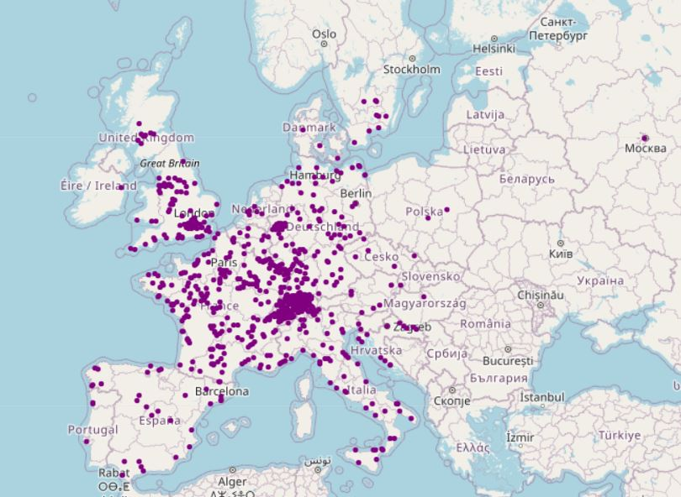
Visualizing initial dataset

Slide 6
Observations from initial dataset
A map of Europe is created with each station highlighted in purple color circle
A significant number of stations are located in Switzerland
The data provides locations heavily centered in western Europe
Major train stations are located is higher frequency around financial hubs (such as Greater London area, Frankfurt, Rhine valley, Paris-Reim, etc..)

Slide 7
Methodology
Venue dataset is merged onto initial dataset and data is cleansed again to remove any invalid entries like “Train stations”, “Airport”, etc..
Most common venues are identified and one hot encoded to create a new dataset
This new dataset is used to divide train stations into clusters
A total of 7 clusters are created.

Slide 8
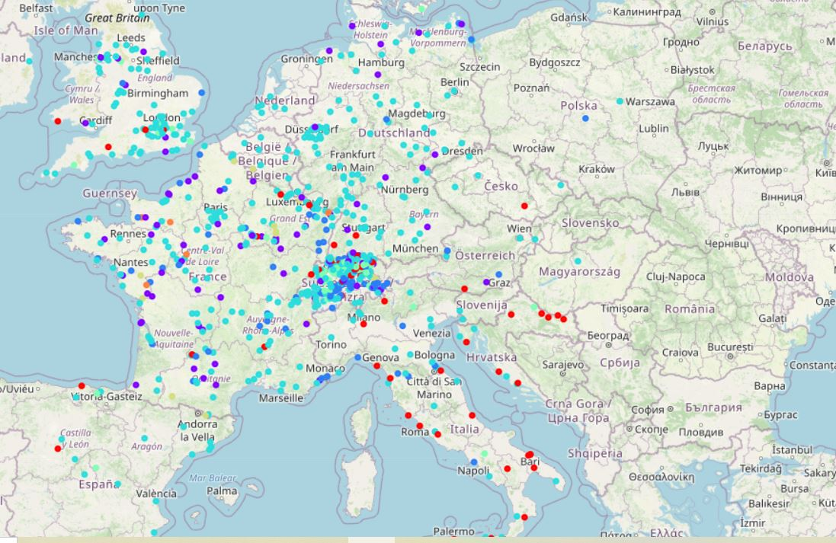
Clusters

Slide 9
Clusters
7 clusters are created
Red cluster: A number of train stations in First cluster are in southern Europe. Most common venues in the first cluster are cafes, bars, Italian restaurants, ice cream shops, etc.. This cluster has at least one public building/service among common venues such as Zoo, exhibit, financial or legal service.
Purple cluster: Second cluster has stations that are surrounded by service based facilities such as super markets, gas stations and stores. In addition to these facilities, a couple of diners or restaurants were in most favored venues. This cluster has majority of stations spread across France, Germany and Switzerland.

Slide 10
Clusters
Blue cluster: Entertainment venues are more common in third clusters. Facilities such as hotels, pools, bars, spas and nightclubs are around the stations that fall into third clusters. Apart from these, at least one public building is available near the third cluster.
Navy blue cluster: Forth cluster covers over 50% of all stations in Europe. This cluster has a good combination of various restaurants, stores and public buildings. Every station in this cluster has 5 or 6 restaurants among the most common venues. Each restaurant has different cuisine. The remaining top venues consists of stores such as pharmacy, game/toy stores, markets along with service buildings.

Slide 11
Clusters
Light blue cluster: Fifth cluster has stations that has a mix of venues and no definitive pattern.
Beige cluster: Sixth cluster has construction spaces, farms and service buildings as most common venues. Restaurants and stores are least favorable here.
Orange cluster: Seventh cluster has banks, Zoos, factories and fairs in their vicinities.

Slide 12
Conclusion
Majority of train stations in Italy and Croatia falls under red cluster that has cafes, bars, Italian restaurants along with public service buildings. If investors are interested in these countries, they can invest in common venues of red cluster.
In western Europe (excluding Italy and Croatia), Fourth cluster has most common venues and is safest best for investment.
If investor is interested in stations in Switzerland, a combination of fourth, first and second clusters are present. These three clusters have restaurants and entertainment venues as safe bet options.

